Slide 1
266 Natural Language Processing
Project: How to Write a Project Research Paper

Slide 2
This Week
Goals
Understand the purpose of a well written NLP paper
Review the structure of a well written project paper

Slide 3
Project Resources
Valuable information in the Project Section of Syllabus
Final Submission
Grading Rubric
FAQ
Older High Scoring Projects

Slide 4
Purpose
How to Write a Good Project Paper

Slide 5
Purpose of a Paper
Clearly communicate:
your idea,
your intuition,
the experiments you’ve designed and run,
The results you got, and
why you got those results
You are telling a coherent story to your colleagues.

Slide 6
Structure
How to Write a Good Project Paper

Slide 7
Paper Structure
Research papers follow a basic structure
Abstract
Introduction (motivation for your work)
Background (literature review, or related work)
Methods (description of your design and implementation)
Results and discussion (tables, plots, & figures, and detailed analysis in comparison to baseline and the literature, if applicable)
Conclusion
References
Appendix

Slide 8
Description of Abstract
Size: 3 to 5 sentences
Concisely describe your problem,
how you solved it,
and what you found

Slide 9
Description of Introduction
Size: 1 page
Focus: motivation for your work
Questions to answer:
What is the problem you are trying to solve?
Why is it important?
Why can’t it be solved without your approach?
What are your contributions?
Substantiate your refutable claims with evidence

Slide 10
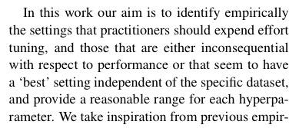
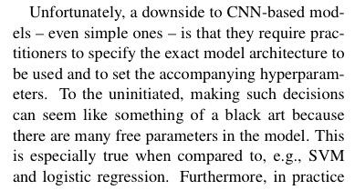
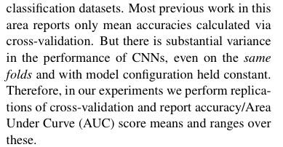
Examples
Their Solution
The Problem
Other’s
Shortcomings
Source: A Sensitivity Analysis of (and Practitioners' Guide to) Convolutional Neural Nets for Sentence Classification

Slide 11
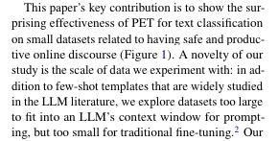
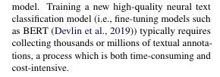
Examples
Their Solution
The Problem
Other’s
Shortcomings
Source: Towards Agile Text Classifiers for Everyone

Slide 12
Description of Background Section
Size: ½ page
Focus: literature review, or related work
Questions to answer:
What have others done?
How were they successful?
How will you go beyond their success?
2-3 Sentences per reference

Slide 13
Description of Methods Section
Size: 2 - 3 pages
Focus: design and implementation
Questions to answer:
What is your proposed approach?
Describe your problem using an example or two.
What is the intuition behind your proposed approach?
How are you solving the problem?
What are your experiments/experimental design?
Why are the experiments helping to solve your problem?
How are you measuring success?

Slide 14
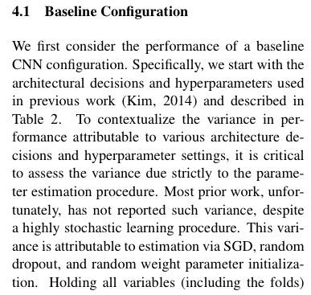
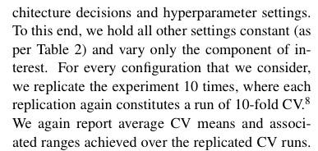
Examples
Experimental Design
Source: A Sensitivity Analysis of (and Practitioners' Guide to) Convolutional Neural Nets for Sentence Classification

Slide 15
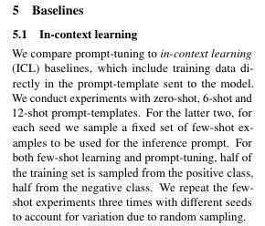
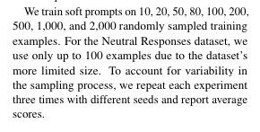
Examples
Experimental Design
Source: Towards Agile Text Classifiers for Everyone

Slide 16
Description of Results and Discussion
Size: 1 - 2 pages
Focus: Analysis
Questions to answer:
How well is your model performing vs. baseline?
What other ways might you measure its success/failure?
Why is your model making the errors it is?
Back up your claims with empirical evidence
At least one table with datasets as rows and experiments as columns
What did you find?
What’s the relationship between the results of your experiments?

Slide 17
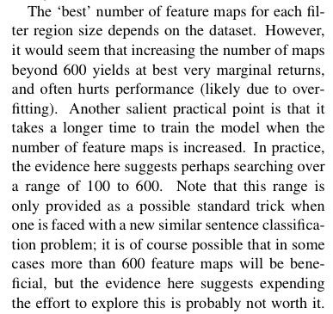
Examples
Analysis:
How Well
Analysis:
Why
Source: A Sensitivity Analysis of (and Practitioners' Guide to) Convolutional Neural Nets for Sentence Classification

Slide 18
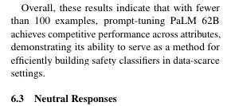
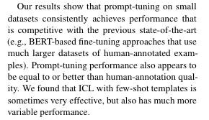
Examples
Analysis:
How Well
Source: Towards Agile Text Classifiers for Everyone

Slide 19
Table in Results and Discussion
Your experiments can be summarized as a table with
Data variants as rows
Experiments as columns
Dataset | Experiment 1 | Experiment 2 | Experiment 3
Data set balanced
Data set unbalanced
Data set two

Slide 20
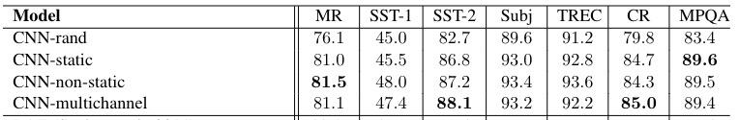
Results and Discussion Table Example
Four experiments on embeddings
Seven different datasets
From Kim (2014) Convolutional Neural Networks for Sentence Classification

Slide 21
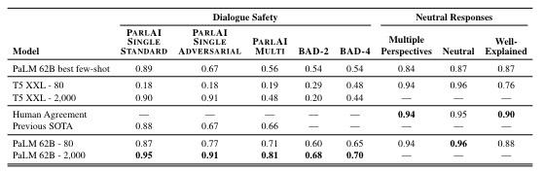
Results and Discussion Table Example
Five experiments on soft prompt tuning
Three datasets
Source: Towards Agile Text Classifiers for Everyone

Slide 22
Description of Conclusion
Size: 3 to 5 sentences
Questions to answer:
What is your problem?
Did you solve it?
What did you find?
Future work (optional)

Slide 23
Description of References and Appendix
References
We want to see that you’ve consulted the literature
Appendix
4 to 6 page limit so put extra results, data samples, etc. in Appendix

Slide 24
Questions?
How to Write a Good Paper

